Slide 1

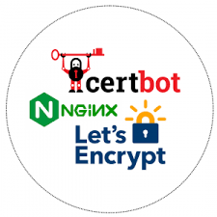






Secure user access via public URL
Push
Let’s Encrypt certificate install
Build and Push Docker Image
Successful Deployment
Deploy via SSH
Container startup

